Slide 1
Suspicious Activity Report (SAR) Clustering Analysis.
Kristina Butler

Slide 2

Suspicious Activity Report (SAR)
Required by Bank Secrecy Act of 1970
Must be filed within 30 days of the initial detection
The purpose of these reports is to identify individuals or organizations involved in money laundering, fraud, terrorist funding operations or any other suspicious activity out of the ordinary
SARs are instrumental in enabling law enforcement to initiate major money laundering or terrorist financing investigations and other criminal cases.

Slide 3


The Project
Cluster Analysis
K-means Clustering method
Main goal: Identify natural clusters in this public SAR filing data to identify specific groups or patterns that highlight not only interesting criminal behavior but also potentially identify interesting SAR filing behavior
Research Question: What states exhibit similar suspicious activity for depository institutions in deposit accounts for 2020
Tools: R, Tableau

Slide 4
The Data
Financial Crimes Enforcement Network government website.
State population Totals: 2010-2019

Slide 5
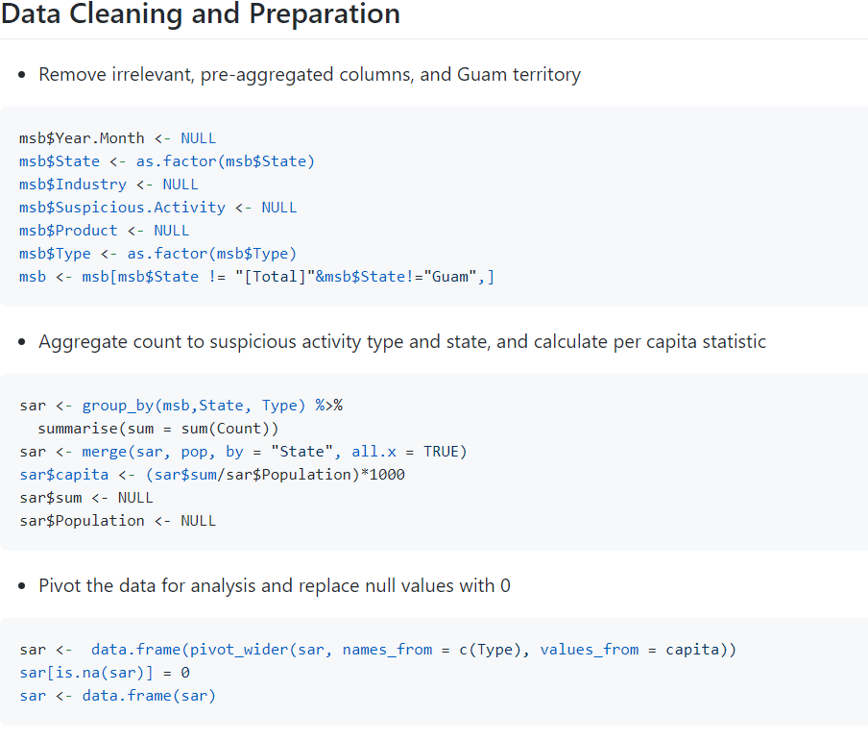
Data Cleaning and Preparation
R for all data cleaning
Packages: dplyr, tidyr
Remove irrelevant, pre-aggregated columns, and Guam territory
Aggregate to the new level of detail and calculate the per capita statistic
Pivot the data and replace the nulls with 0

Slide 6
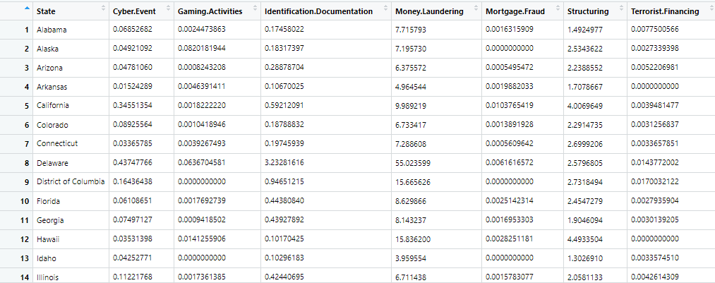
Data for analysis

Slide 7
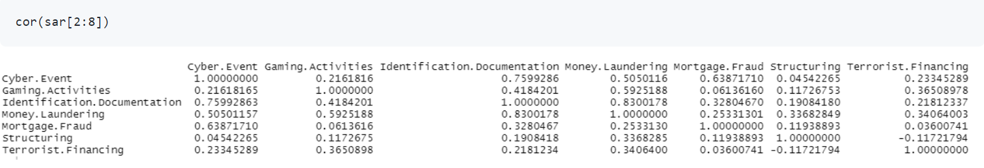
EDA Findings and Feature Selection
3,460,668 suspicious activity observations and 8 columns
Summary()
Cor()

Slide 8
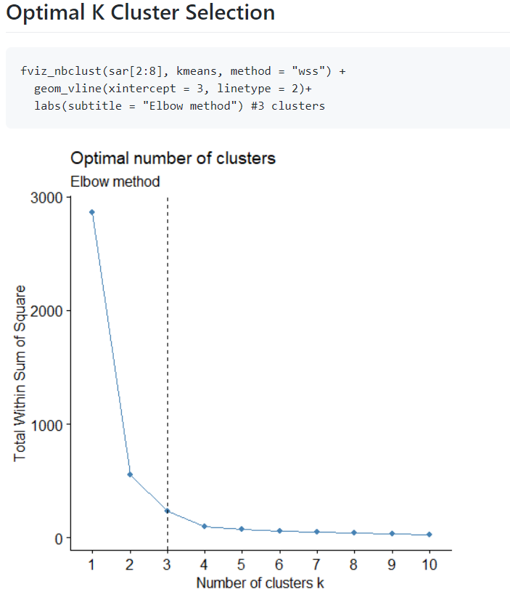
Optimal Number of Clusters
“Elbow” method or WSS
3 was determined as the optimal number of clusters.
Compare 2, 3, and 4 Clusters

Slide 9
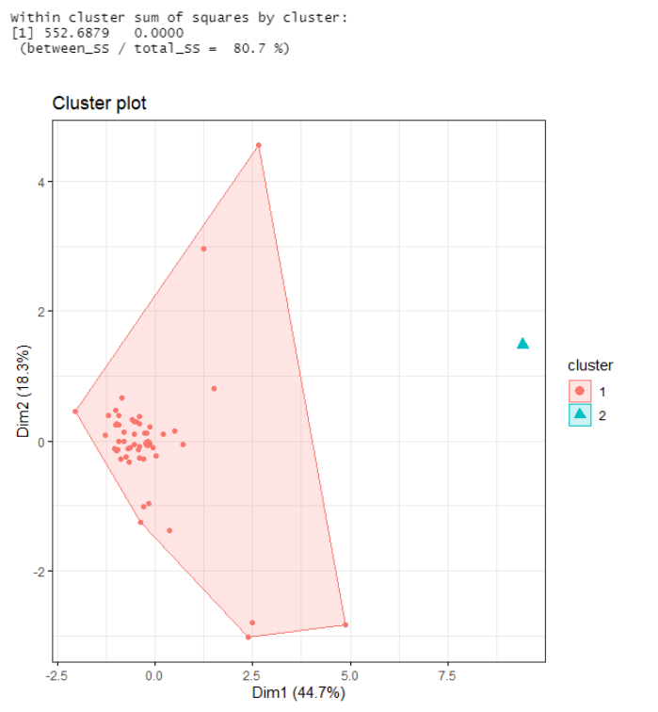
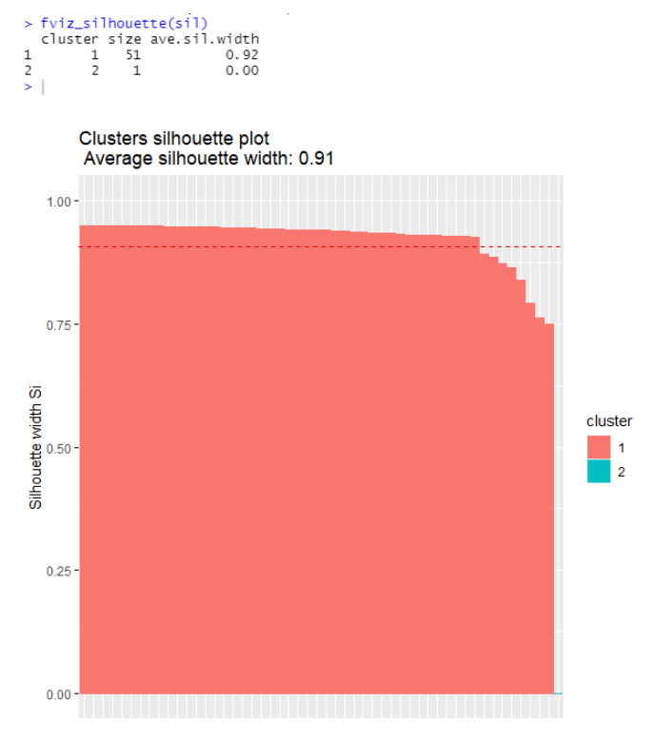
2 Clusters
81% compactness
Distribution:
Cluster 1: 51 states
Cluster 2: 1 state
Avg Silhouette width: .91
Cluster 1: .92

Slide 10
3 Clusters
92% compactness
Distribution:
Cluster 1: 7 states
Cluster 2: 1 state
Cluster 3: 44 States
Avg Silhouette width: .63
Cluster 1: .45
Cluster 3: .68

Slide 11
4 Clusters
97% compactness
Distribution:
Cluster 1: 5 states
Cluster 2: 27 states
Cluster 3: 1 State
Cluster 4: 19 States
Avg Silhouette width: .63
Cluster 1: .47
Cluster 2: .60
Cluster 4: .51

Slide 12
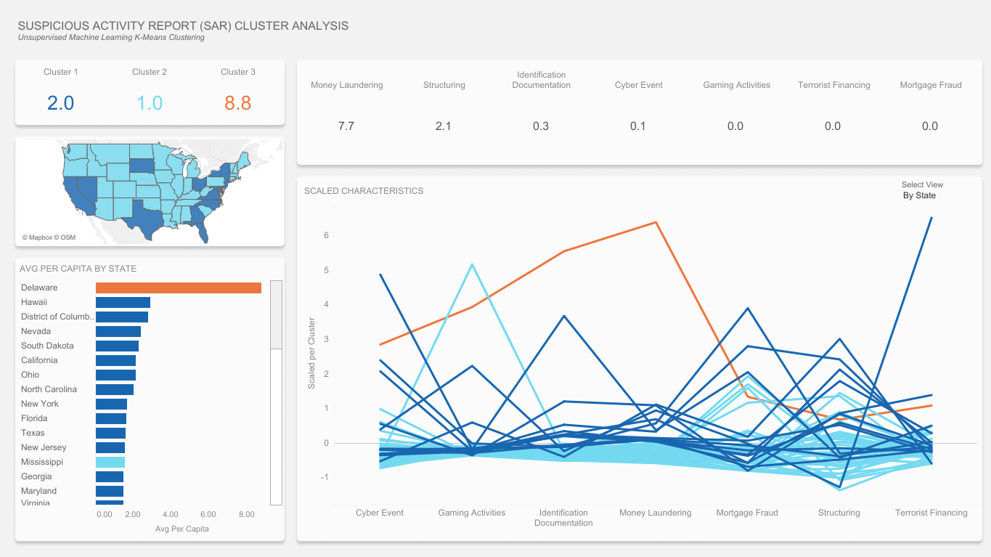
Evaluating Results Interactive Dashboard

Slide 13
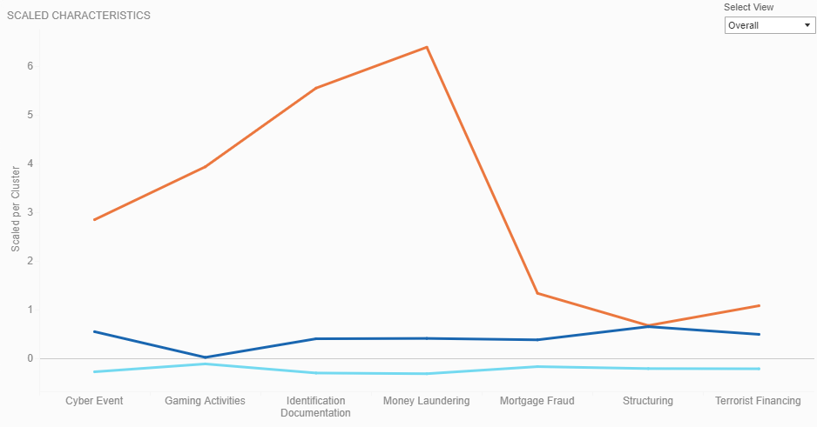
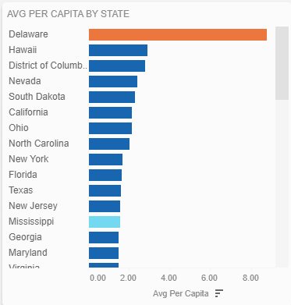
Evaluating results
Cluster 1: Higher SAR filings per Capita
Cluster 2: Lower SAR filing per Capita
Cluster 3: Delaware

Slide 14
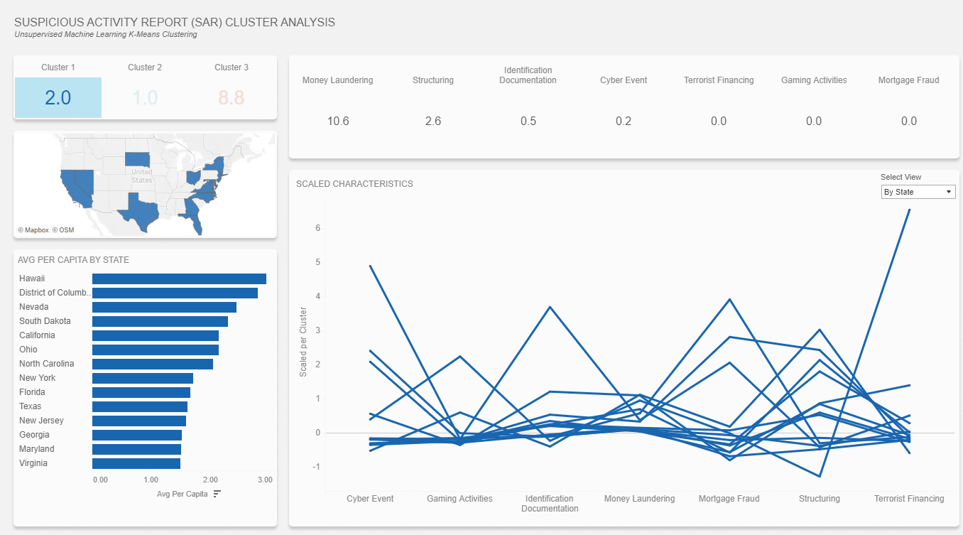
Evaluating results – Cluster 1
Ohio – Cyber Events and Identification documentation
North Carolina – Mortgage Fraud
Hawaii – Structuring
South Dakota – Terrorist Financing

Slide 15
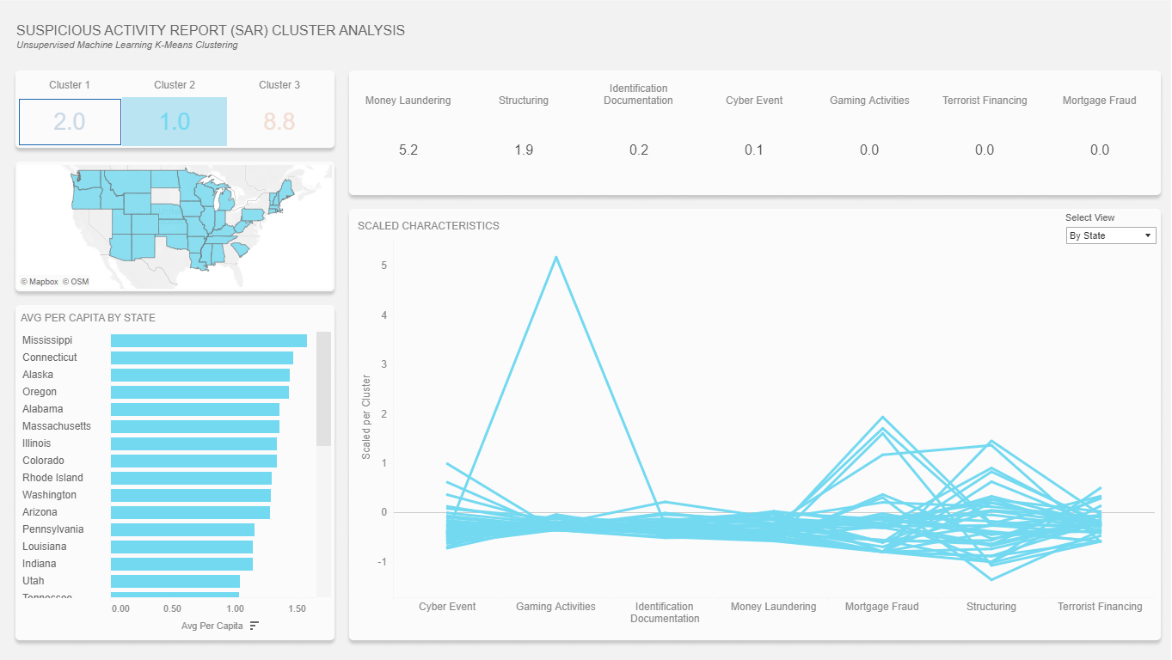
Evaluating results – Cluster 2
Majority of the states.
Alaska – Gaming Activities
Small spikes in Mortgage fraud and structuring

Slide 16
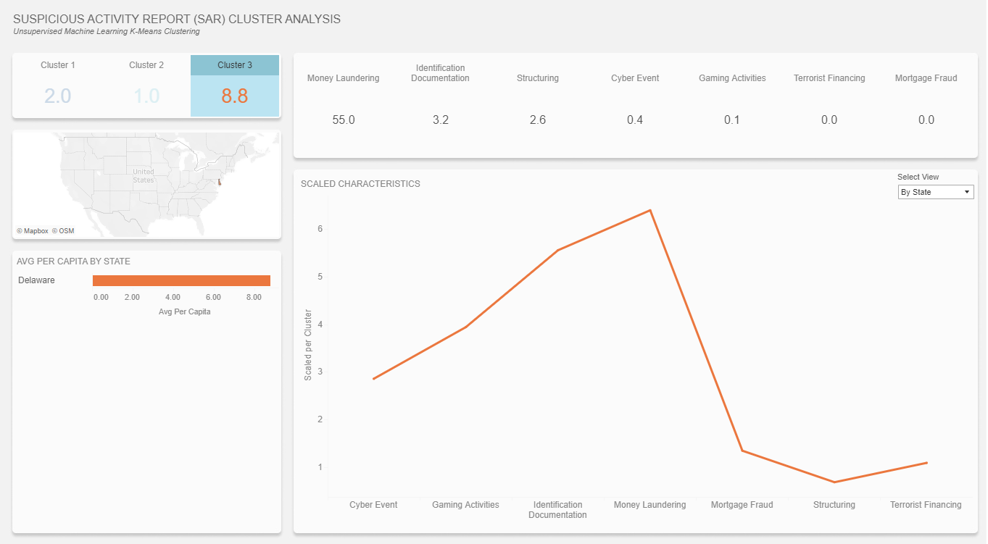
Evaluating results – Cluster 3
What is happening in Delaware?!?
Major deviation in money laundering, identification documentation, gaming activities, and cyber event
More businesses registered than population
Law protecting beneficial owners

Slide 17
Conclusions and Lessons Learned

Slide 18
References
Kenton, W. (2020, September 09). Suspicious activity report (sar) definition. Retrieved February 28, 2021, from https://www.investopedia.com/terms/s/suspicious-activity-report.asp
Rashmi, Kassambara 06 May 2020 The demo data used in this tutorial is available in the default installation of R. Juste type data(“USArrests”) Reply, & Kassambara. (2018, October 21). K-Means clustering in R: Algorithm and practical examples. Retrieved February 28, 2021, from https://www.datanovia.com/en/lessons/k-means-clustering-in-r-algorith-and-practical-examples/
Kassambara, Visitor, Kassambara, Visitor_Luigi, Fdtd, & Visitor_Ann. (2017, September 07). Determining the optimal number of clusters: 3 must know methods. Retrieved February 28, 2021, from http://www.sthda.com/english/articles/29-cluster-validation-essentials/96-determiningthe-optimal-number-of-clusters-3-must-know-methods/
SAR stats. (n.d.). Retrieved February 28, 2021, from https://www.fincen.gov/reports/sar-stats
Bureau, U. (2019, December 30). State population Totals: 2010-2019. Retrieved February 28, 2021, from https://www.census.gov/data/tables/time-series/demo/popest/2010s-state-total.html#par_textimage_1574439295
Khandelwal, R. (2020, December 07). Evaluating goodness of clustering for unsupervised learning case. Retrieved February 28, 2021, from https://towardsdatascience.com/evaluating-goodness-of-clustering-for-unsupervised-learning-case-ccebcfd1d4f1
Tarver, E. (2021, January 01). Why Delaware is considered a tax shelter. Retrieved March 02, 2021, from https://www.investopedia.com/articles/personal-finance/092515/4-reasons-why-delaware-considered-tax-shelter.asp
Bartels, J. (2019, April 06). Discreet Delaware: Why corporate secrecy and money LAUNDERING have thrived in the US. Retrieved March 02, 2021, from https://www.biia.com/discreet-delaware-why-corporate-secrecy-and-money-laundering-have-thrived-in-the-us

